Slide 1
How many numbers are above 100?
23 | 32 | 71 | 72 | 58 | 87 | 11 | 77 | 70 | 16
17 | 21 | 56 | 44 | 68 | 51 | 84 | 20 | 60 | 40
37 | 8 | 107 | 14 | 12 | 41 | 69 | 14 | 18 | 71
62 | 55 | 59 | 64 | 33 | 55 | 71 | 58 | 103 | 92
101 | 56 | 45 | 34 | 43 | 15 | 73 | 78 | 6 | 93
39 | 53 | 22 | 26 | 26 | 94 | 60 | 82 | 99 | 74
11 | 12 | 36 | 67 | 70 | 71 | 97 | 59 | 73 | 99
75 | 74 | 69 | 69 | 51 | 48 | 2 | 66 | 92 | 98
15 | 10 | 41 | 58 | 104 | 94 | 92 | 84 | 74 | 82
12 | 52 | 10 | 57 | 33 | 77 | 88 | 81 | 81 | 91
15 | 56 | 25 | 30 | 21 | 7 | 66 | 66 | 78 | 87
29 | 23 | 5 | 34 | 11 | 96 | 74 | 99 | 99 | 88
37 | 10 | 43 | 15 | 50 | 71 | 65 | 60 | 101 | 98
46 | 34 | 19 | 102 | 57 | 70 | 95 | 84 | 63 | 91
3 | 34 | 39 | 37 | 60 | 81 | 65 | 63 | 9 | 71
48 | 46 | 25 | 50 | 22 | 64 | 91 | 76 | 71 | 79

Slide 2
How many numbers are below 10?
23 | 32 | 71 | 72 | 58 | 87 | 11 | 77 | 70 | 16
17 | 21 | 56 | 44 | 68 | 51 | 84 | 20 | 60 | 40
37 | 8 | 107 | 14 | 12 | 41 | 69 | 14 | 18 | 71
62 | 55 | 59 | 64 | 33 | 55 | 71 | 58 | 103 | 92
101 | 56 | 45 | 34 | 43 | 15 | 73 | 78 | 6 | 93
39 | 53 | 22 | 26 | 26 | 94 | 60 | 82 | 99 | 74
11 | 12 | 36 | 67 | 70 | 71 | 97 | 59 | 73 | 99
75 | 74 | 69 | 69 | 51 | 48 | 2 | 66 | 92 | 98
15 | 10 | 41 | 58 | 104 | 94 | 92 | 84 | 74 | 82
12 | 52 | 10 | 57 | 33 | 77 | 88 | 81 | 81 | 91
15 | 56 | 25 | 30 | 21 | 7 | 66 | 66 | 78 | 87
29 | 23 | 5 | 34 | 11 | 96 | 74 | 99 | 99 | 88
37 | 10 | 43 | 15 | 50 | 71 | 65 | 60 | 101 | 98
46 | 34 | 19 | 102 | 57 | 70 | 95 | 84 | 63 | 91
3 | 34 | 39 | 37 | 60 | 81 | 65 | 63 | 9 | 71
48 | 46 | 25 | 50 | 22 | 64 | 91 | 76 | 71 | 79

Slide 3
Which quadrant has the highest total?
23 | 32 | 71 | 72 | 58 | 87 | 11 | 77 | 70 | 16
17 | 21 | 56 | 44 | 68 | 51 | 84 | 20 | 60 | 40
37 | 8 | 107 | 14 | 12 | 41 | 69 | 14 | 18 | 71
62 | 55 | 59 | 64 | 33 | 55 | 71 | 58 | 103 | 92
101 | 56 | 45 | 34 | 43 | 15 | 73 | 78 | 6 | 93
39 | 53 | 22 | 26 | 26 | 94 | 60 | 82 | 99 | 74
11 | 12 | 36 | 67 | 70 | 71 | 97 | 59 | 73 | 99
75 | 74 | 69 | 69 | 51 | 48 | 2 | 66 | 92 | 98
15 | 10 | 41 | 58 | 104 | 94 | 92 | 84 | 74 | 82
12 | 52 | 10 | 57 | 33 | 77 | 88 | 81 | 81 | 91
15 | 56 | 25 | 30 | 21 | 7 | 66 | 66 | 78 | 87
29 | 23 | 5 | 34 | 11 | 96 | 74 | 99 | 99 | 88
37 | 10 | 43 | 15 | 50 | 71 | 65 | 60 | 101 | 98
46 | 34 | 19 | 102 | 57 | 70 | 95 | 84 | 63 | 91
3 | 34 | 39 | 37 | 60 | 81 | 65 | 63 | 9 | 71
48 | 46 | 25 | 50 | 22 | 64 | 91 | 76 | 71 | 79

Slide 4
How many numbers are above 100?
23 | 32 | 71 | 72 | 58 | 87 | 11 | 77 | 70 | 16
17 | 21 | 56 | 44 | 68 | 51 | 84 | 20 | 60 | 40
37 | 8 | 107 | 14 | 12 | 41 | 69 | 14 | 18 | 71
62 | 55 | 59 | 64 | 33 | 55 | 71 | 58 | 103 | 92
101 | 56 | 45 | 34 | 43 | 15 | 73 | 78 | 6 | 93
39 | 53 | 22 | 26 | 26 | 94 | 60 | 82 | 99 | 74
11 | 12 | 36 | 67 | 70 | 71 | 97 | 59 | 73 | 99
75 | 74 | 69 | 69 | 51 | 48 | 2 | 66 | 92 | 98
15 | 10 | 41 | 58 | 104 | 94 | 92 | 84 | 74 | 82
12 | 52 | 10 | 57 | 33 | 77 | 88 | 81 | 81 | 91
15 | 56 | 25 | 30 | 21 | 7 | 66 | 66 | 78 | 87
29 | 23 | 5 | 34 | 11 | 96 | 74 | 99 | 99 | 88
37 | 10 | 43 | 15 | 50 | 71 | 65 | 60 | 101 | 98
46 | 34 | 19 | 102 | 57 | 70 | 95 | 84 | 63 | 91
3 | 34 | 39 | 37 | 60 | 81 | 65 | 63 | 9 | 71
48 | 46 | 25 | 50 | 22 | 64 | 91 | 76 | 71 | 79

Slide 5
How many numbers are below 10?
23 | 32 | 71 | 72 | 58 | 87 | 11 | 77 | 70 | 16
17 | 21 | 56 | 44 | 68 | 51 | 84 | 20 | 60 | 40
37 | 8 | 107 | 14 | 12 | 41 | 69 | 14 | 18 | 71
62 | 55 | 59 | 64 | 33 | 55 | 71 | 58 | 103 | 92
101 | 56 | 45 | 34 | 43 | 15 | 73 | 78 | 6 | 93
39 | 53 | 22 | 26 | 26 | 94 | 60 | 82 | 99 | 74
11 | 12 | 36 | 67 | 70 | 71 | 97 | 59 | 73 | 99
75 | 74 | 69 | 69 | 51 | 48 | 2 | 66 | 92 | 98
15 | 10 | 41 | 58 | 104 | 94 | 92 | 84 | 74 | 82
12 | 52 | 10 | 57 | 33 | 77 | 88 | 81 | 81 | 91
15 | 56 | 25 | 30 | 21 | 7 | 66 | 66 | 78 | 87
29 | 23 | 5 | 34 | 11 | 96 | 74 | 99 | 99 | 88
37 | 10 | 43 | 15 | 50 | 71 | 65 | 60 | 101 | 98
46 | 34 | 19 | 102 | 57 | 70 | 95 | 84 | 63 | 91
3 | 34 | 39 | 37 | 60 | 81 | 65 | 63 | 9 | 71
48 | 46 | 25 | 50 | 22 | 64 | 91 | 76 | 71 | 79

Slide 6
Which quadrant has the highest total?
23 | 32 | 71 | 72 | 58 | 87 | 11 | 77 | 70 | 16
17 | 21 | 56 | 44 | 68 | 51 | 84 | 20 | 60 | 40
37 | 8 | 107 | 14 | 12 | 41 | 69 | 14 | 18 | 71
62 | 55 | 59 | 64 | 33 | 55 | 71 | 58 | 103 | 92
101 | 56 | 45 | 34 | 43 | 15 | 73 | 78 | 6 | 93
39 | 53 | 22 | 26 | 26 | 94 | 60 | 82 | 99 | 74
11 | 12 | 36 | 67 | 70 | 71 | 97 | 59 | 73 | 99
75 | 74 | 69 | 69 | 51 | 48 | 2 | 66 | 92 | 98
15 | 10 | 41 | 58 | 104 | 94 | 92 | 84 | 74 | 82
12 | 52 | 10 | 57 | 33 | 77 | 88 | 81 | 81 | 91
15 | 56 | 25 | 30 | 21 | 7 | 66 | 66 | 78 | 87
29 | 23 | 5 | 34 | 11 | 96 | 74 | 99 | 99 | 88
37 | 10 | 43 | 15 | 50 | 71 | 65 | 60 | 101 | 98
46 | 34 | 19 | 102 | 57 | 70 | 95 | 84 | 63 | 91
3 | 34 | 39 | 37 | 60 | 81 | 65 | 63 | 9 | 71
48 | 46 | 25 | 50 | 22 | 64 | 91 | 76 | 71 | 79

Slide 7
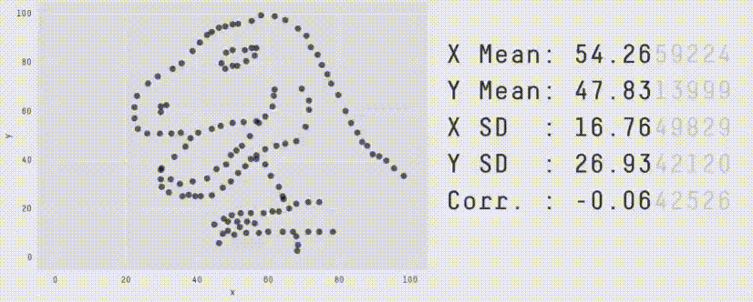
Visually representing data helps us to see patterns in the data quickly
“The greatest value of a picture is when it forces us to notice what we never expected to see.” — John Tukey
Datasauras dataset, animated by Autodesk Research

Slide 8
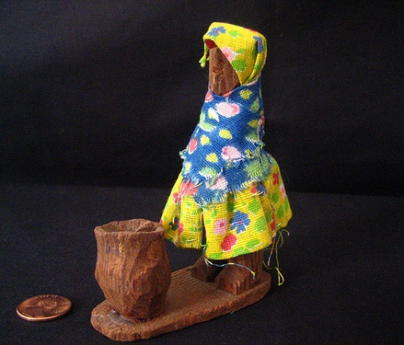
Stories have a huge impact on humans
Storytelling has a 30X Return on Investment
Rob Walker and Joshua Glenn auctioned common items like mugs, golf balls, toys, etc. The item descriptions were stories purpose-written by 200+ contributing writers.
Items that were bought for $250 sold for over $8,000 – a return of over 3,000% for storytelling!
Original price: $2.00.
Final price: $50.00.
This little statue stood on the window-sill in my favorite aunt’s front hall. Perched between plants of varying shapes and sizes, surrounded by shards of broken pottery and miniature ceramic elephants from the Red Rose Tea box, dappled with sunlight shining through the leaded glass figures of St. Francis in his garden and the mossy Celtic Cross, …
Notes:
Feedback from Aqeel + Animate

Slide 9
Stories are memorable and viral
People remember stories. They’ll act on them.
People share stories. That enables collective action.
We analyze data to improve people’s decision making. For this to be effective, data stories are needed more than ever before.

Slide 10
But analysts present their work, not their message
Data scientists present their analysis – what they did, and what they found. That’s not what the audience needs.
Audiences need a message that tells them what to do, and why. Told in an engaging way. As a story.
Notes:
Feedback from Aqeel + Animate

Slide 11
Share your data & analysis as data stories
Whenever you share inferences from data – whether it’s as a presentation, or an email or document with your analysis, or as a dashboard – craft it as a story.
Hopefully by the end of this workshop, you’ll be able to make your own data stories!
Notes:
Feedback from Aqeel + Animate

Slide 12
Milestones: Timeline of developments
A brief history of data visualization Michael Friendly∗ March 21, 2006

Slide 13
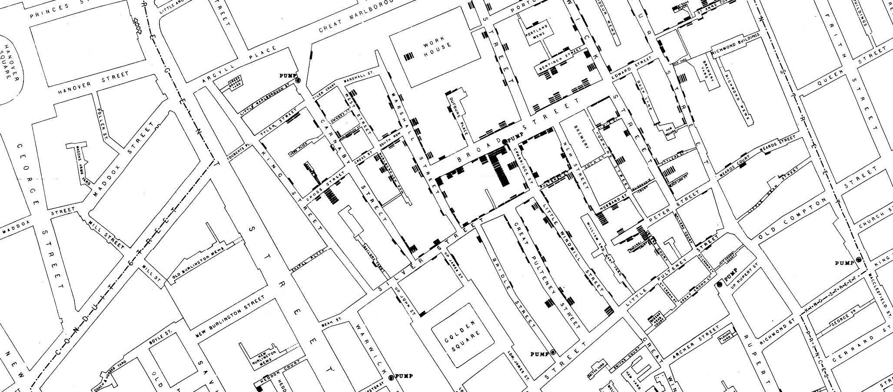
We’ve been telling stories with data for a long time…
John Snow’s Cholera Map from Wikimedia
Notes:
In 1854, London suffered from a Cholera epidemic. The popular theory at that time was that cholera was caused by pollution. Dr. John Snow was sceptical about this. By talking to local residents, he identified the source of the outbreak as the public water pump on Broad Street. Dr. Snow used this map to illustrate the cluster of cholera cases around the pump. He also used statistics to illustrate the connection between the quality of the water source and cholera cases. This visual was convincing enough to persuade the local council to disable the well pump by removing its handle, is regarded as the founding event of the science of epidemiology.

Slide 14
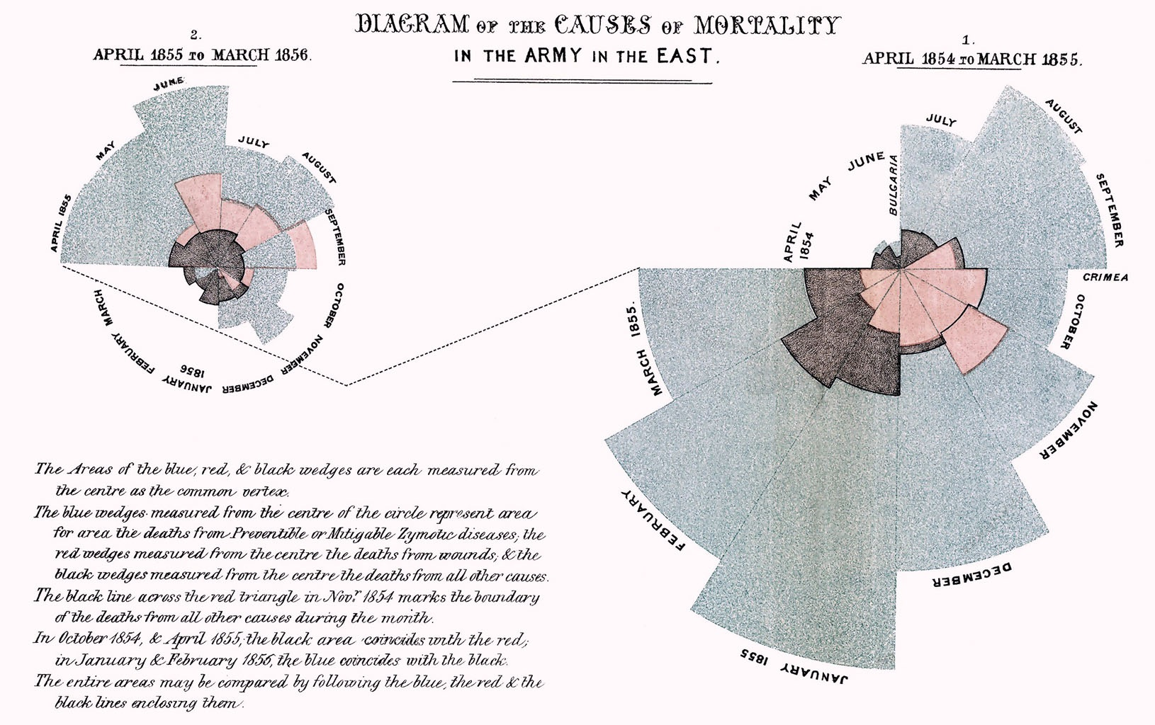
…and using data to persuade stakeholders…

Slide 15
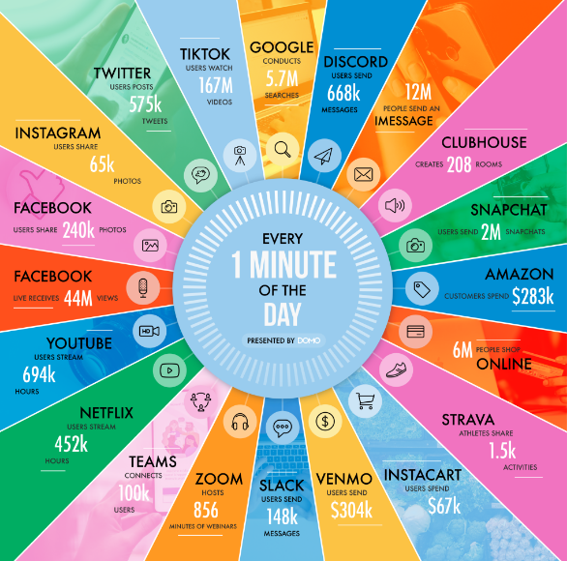
…but the overload of data in today’s age makes this critical
“Every second of every day, our senses bring in way too much data than we can possibly process in our brains.” – Peter Diamandis
Data never sleeps Infographic by Domo

Slide 16
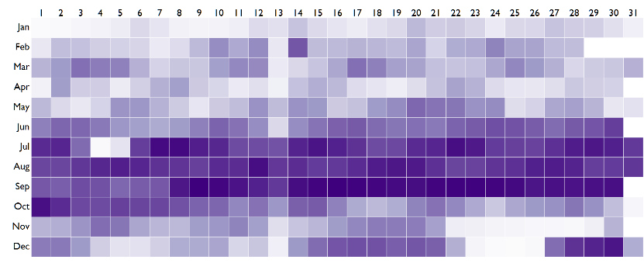
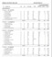
Let’s look at 15 years of US Birth Data
This is a dataset (1975 – 1990) that has been around for several years and has been studied extensively. Yet, a visualization can reveal patterns that are neither obvious nor well known.
For example,
Are birthdays uniformly distributed?
Do doctors or parents exercise the C-section option to move dates?
Is there any day of the month that has unusually high or low births?
Are there any months with relatively high or low births?
More births
Fewer births
… on average, for each day of the year (from 1975 to 1990)
Some special days like April Fool’s day are avoided, but Valentine’s Day is quite popular
Most people prefer not to have children on the 13th of any month, given that it’s an unlucky day
Relatively few births during the Christmas and Thanksgiving holidays, as well as New Year and Independence Day.
Very high births in September. But this is fairly well known. Most conceptions happen during the winter holiday season
https://gramener.com/posters/Birthdays.pdf

Slide 17
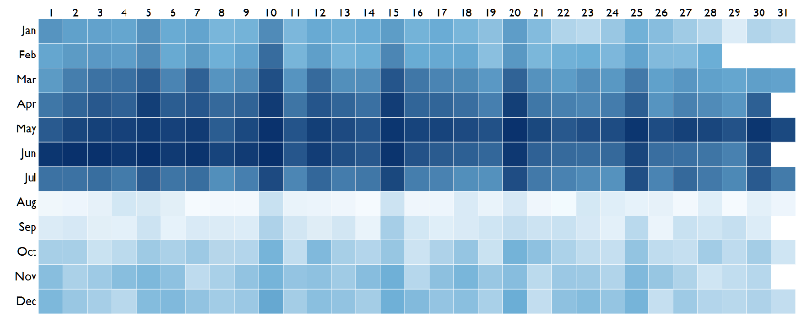
The pattern in India is quite different
This is a birth date dataset that’s obtained from school admission data for over 10 million children. When we compare this with births in the US, we see none of the same patterns.
For example,
Is there an aversion to the 13th or is there a local cultural nuance?
Are holidays avoided for births?
Which months have a higher propensity for births, and why?
Are there any patterns not found in the US data?
More births
Fewer births
… on average, for each day of the year (from 2007 to 2013)
Such round numbered patterns a typical indication of fraud. Here, birthdates are brought forward to aid early school admission
We see a large number of children born on the 5th, 10th, 15th, 20th and 25th of each month – that is, round numbered dates
Very few children are born in the month of August, and thereafter. Most births are concentrated in the first half of the year
https://gramener.com/posters/Birthdays.pdf

Slide 18
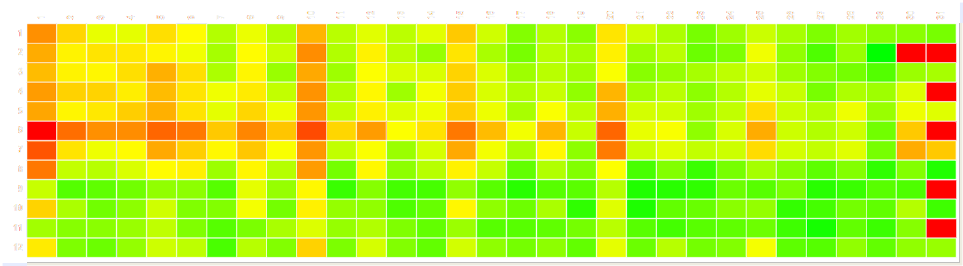
This adversely impacts children’s marks
It’s a well-established fact that older children tend to do better at school in most activities. Since many children have had their birth dates brought forward, these younger children suffer.
The average marks of children “born” on the 1st, 5th, 10th, 15th etc.. of the month tend to score lower marks.
Are holidays avoided for births?
Which months have a higher propensity for births, and why?
Are there any patterns not found in the US data?
Higher marks
Lower marks
… on average, for children born on a given day of the year (from 2007 to 2013)
Children “born” on round numbered days score lower marks on average,
due to a higher proportion of younger children
https://gramener.com/posters/Birthdays.pdf

Slide 19
What can design do with data?
The 5 E’s of data visualization goals.

Slide 20
Exhibit
Explain
Explore
Experience
Enable

Slide 21
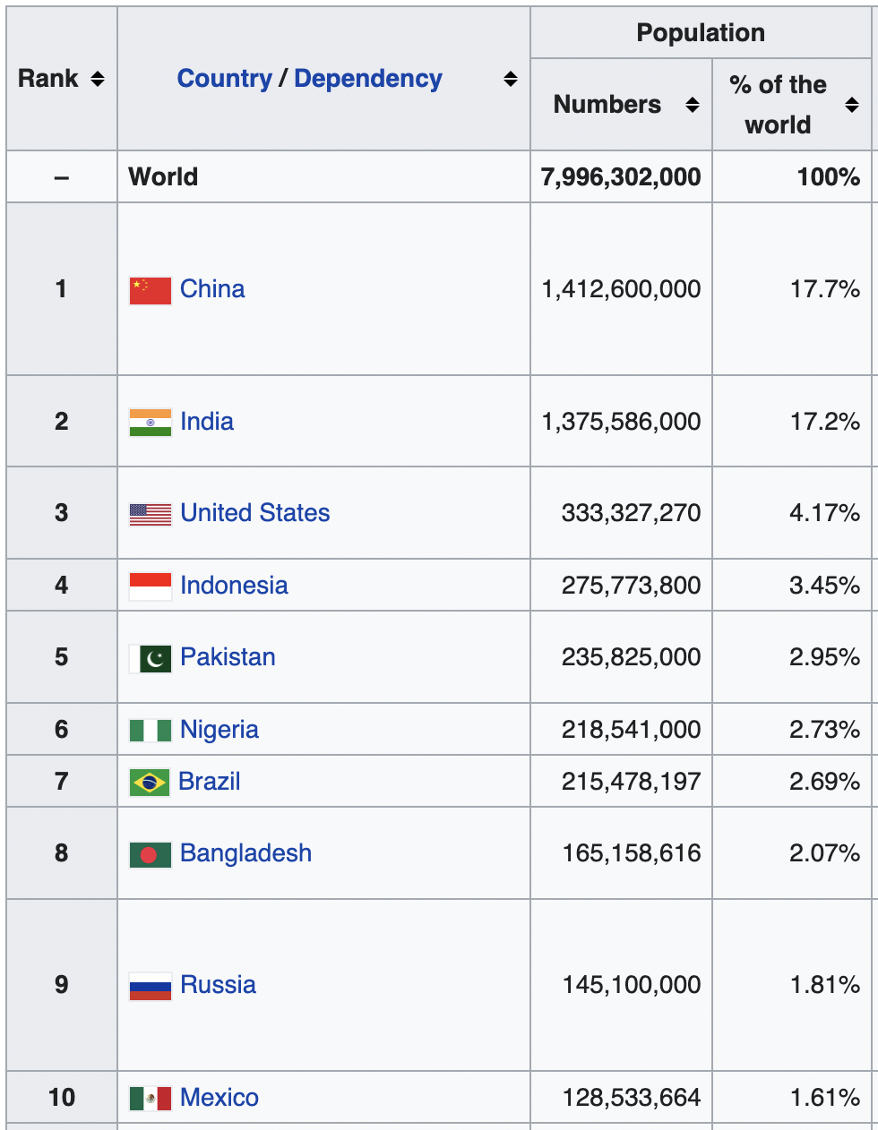
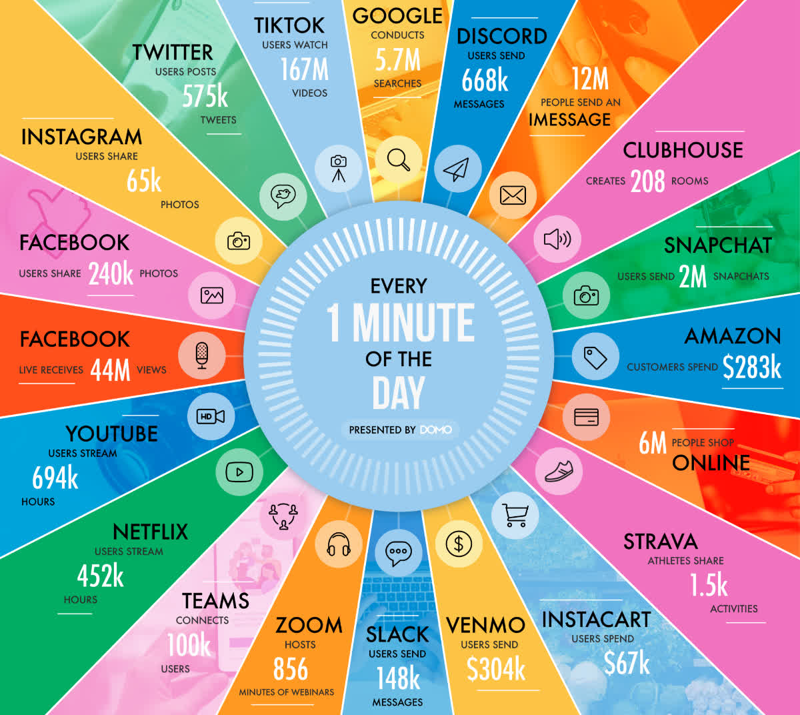
Exhibit List, Table Infographic* … (Showing raw data)
Wikipedia Country Population
A minute on the Internet

Slide 22
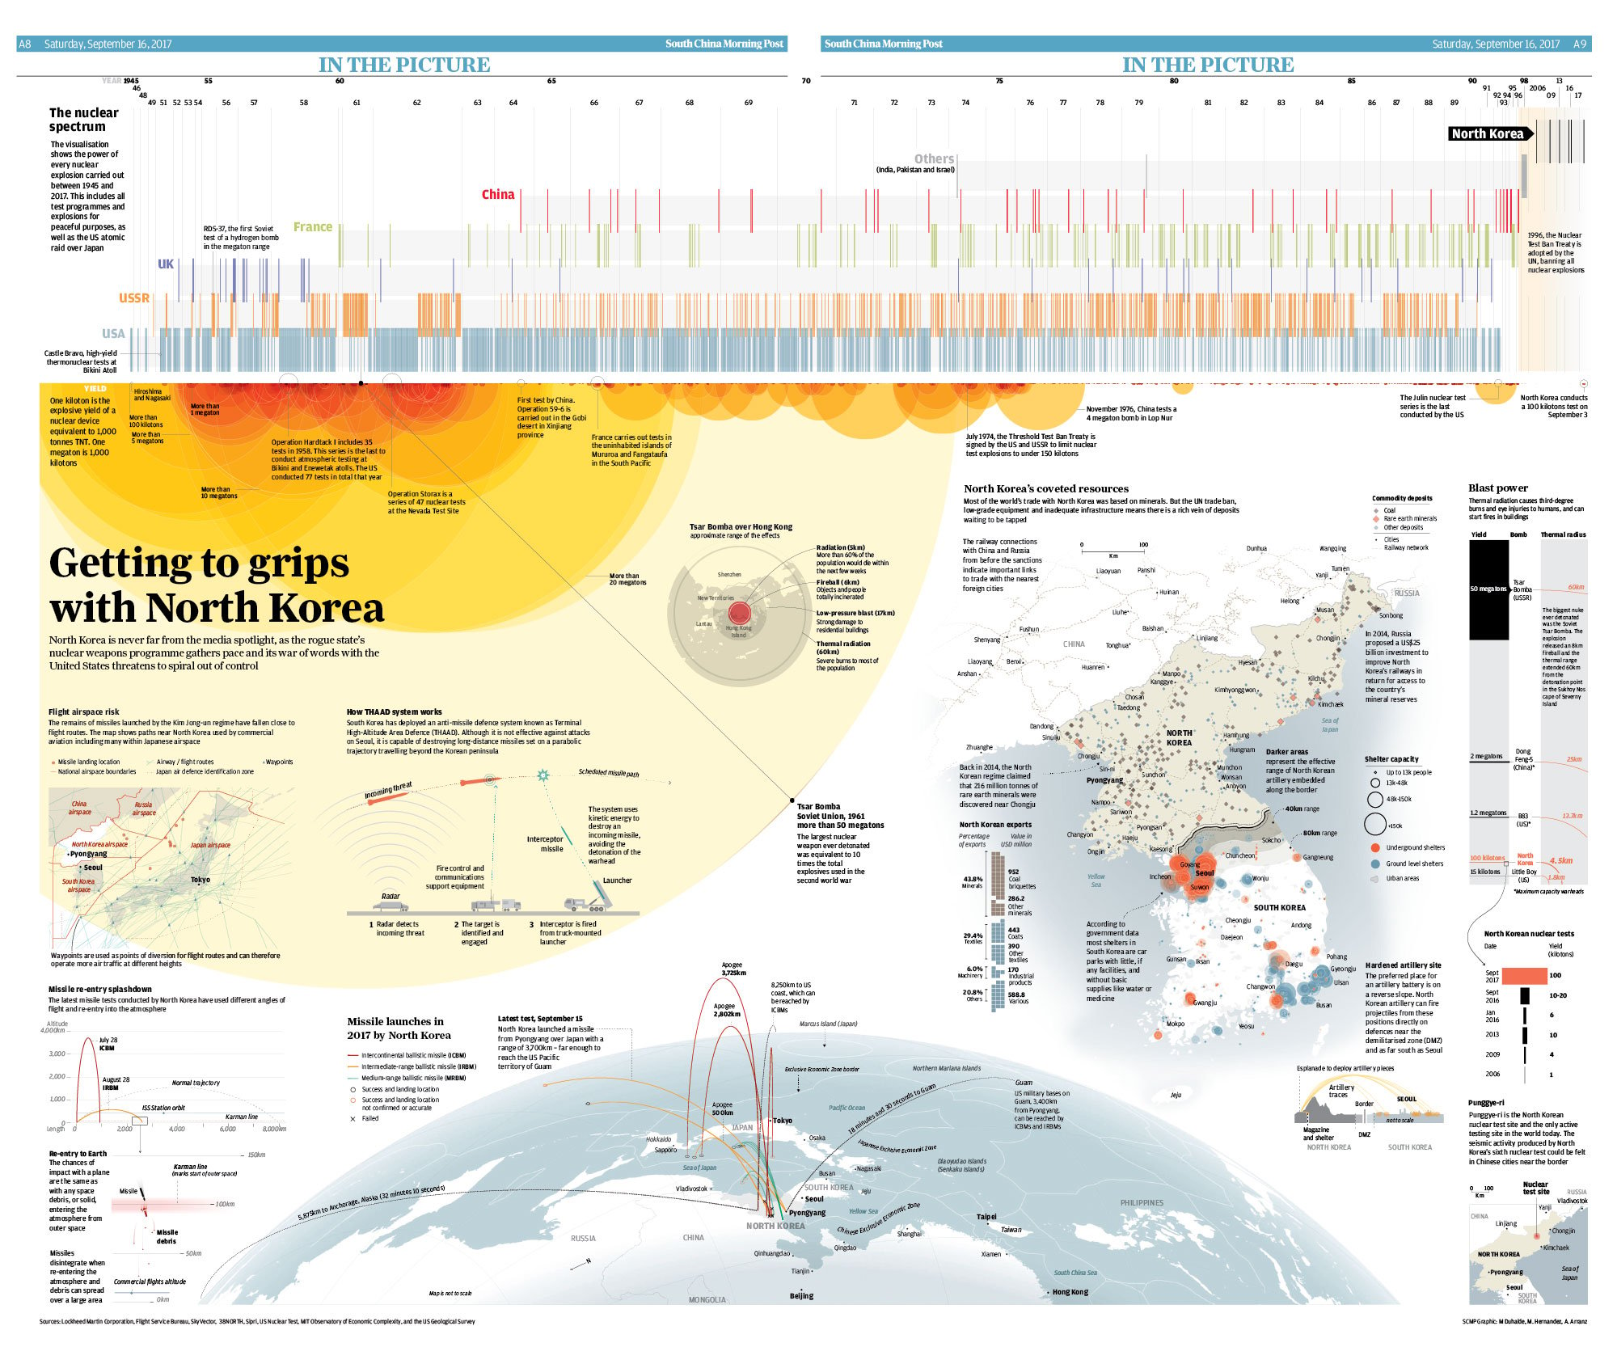
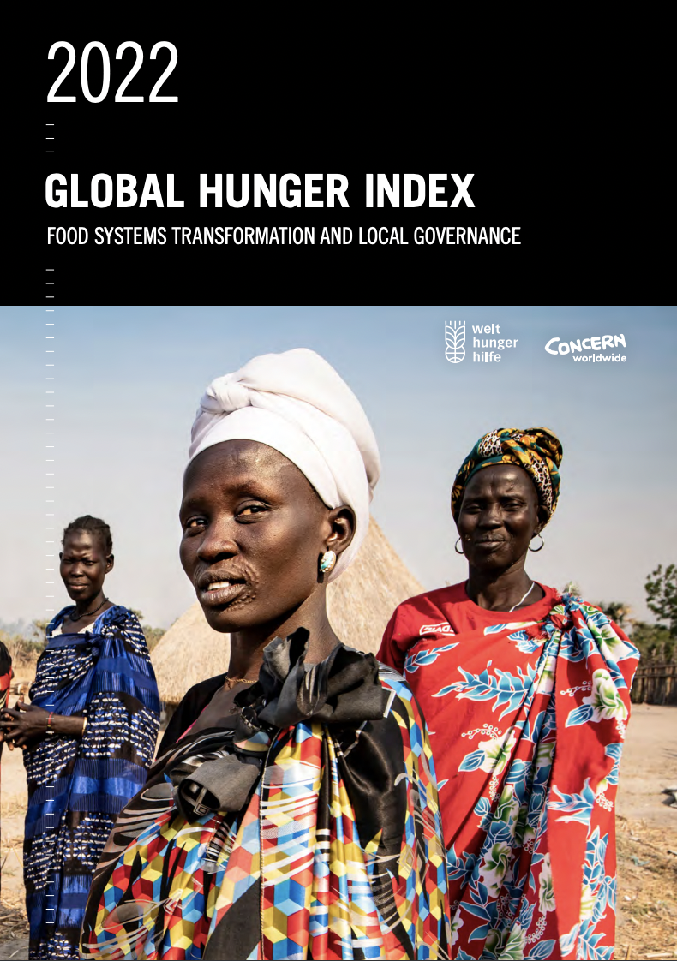
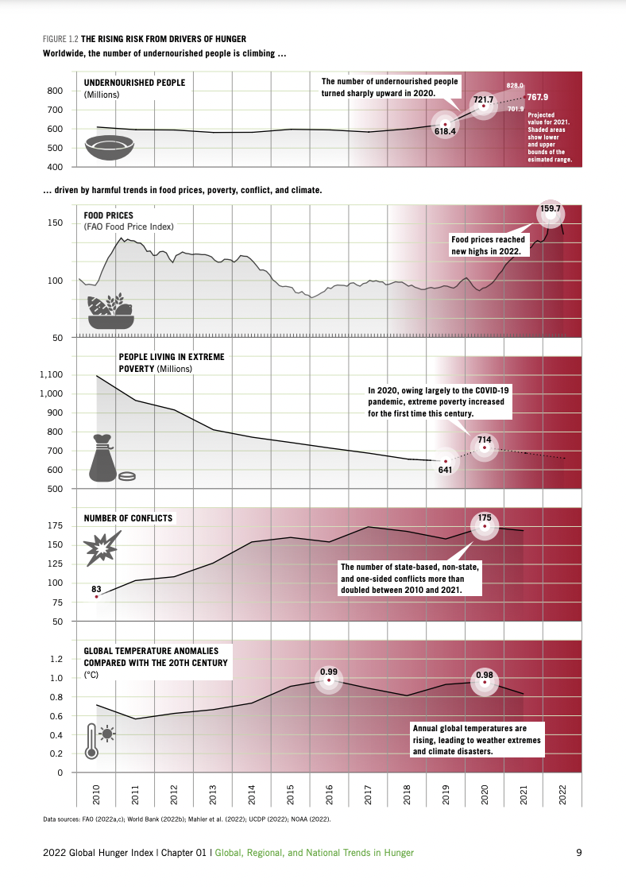
Explain Data journalism Report … (Answering questions)
South China Morning Post
Global Hunger Index

Slide 23
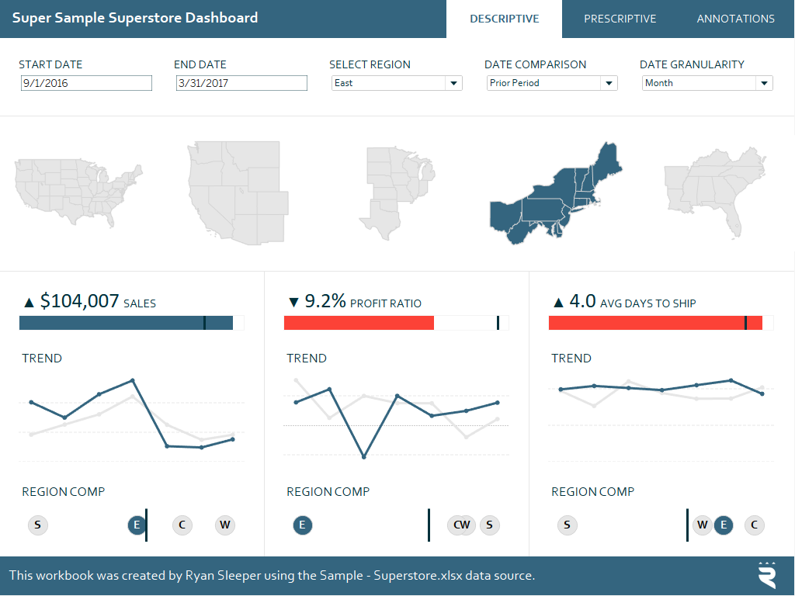
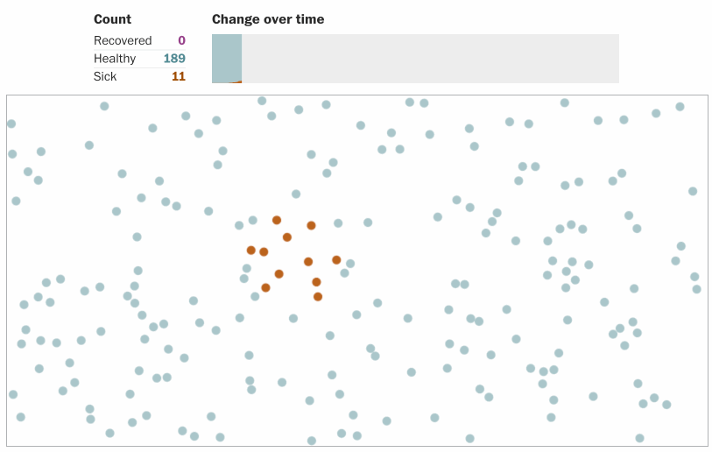
Explore Dashboard Simulation … (Finding what to ask)
Super Store Dashboard by Ryan Sleeper
Corona Simulator by Washington Post

Slide 24

Experience Data art piece New-media installations … (Finding meaning in data)
Bruises by Giorgia Lupi
Virtual Depictions by Refik Andol

Slide 25
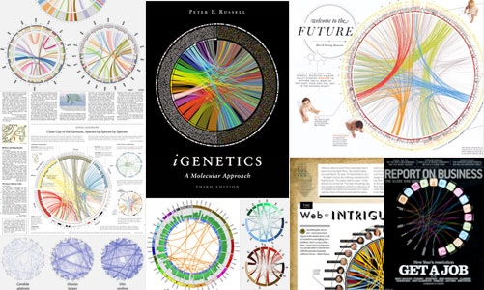

Enable Software for visualizing data … (Building tools to visualize specific use cases)
Circos: Complex Circular Layouts
Narrative Science x Tableau

